Slide 1
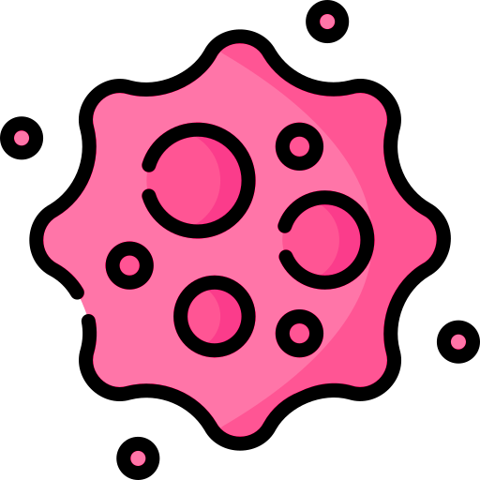
Skin Cancer Detection App

Slide 2
Supervisor: Dr/Mohamed Attia
Teacher Assistant:
Eng/Mohamed Hussen Kamel
Team Members:
Mohamed Hamdy Mahran
Adham Mohamed Ahmed
Rahma Alaa Fouad Ibrahim
Nour Hassan El-Sayed Ali
Marina Medhat Shawky
Marina Emad Monir
Mai Ibrahim Abdel-Samea

Slide 3
Agenda
Introduction
Related Works
Comparison
Machine-Learning
System Design
Backend
System Demo
Conclusion

Slide 4
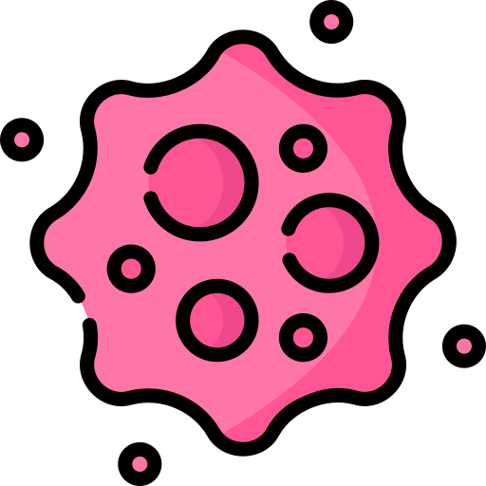
Introduction

Slide 5
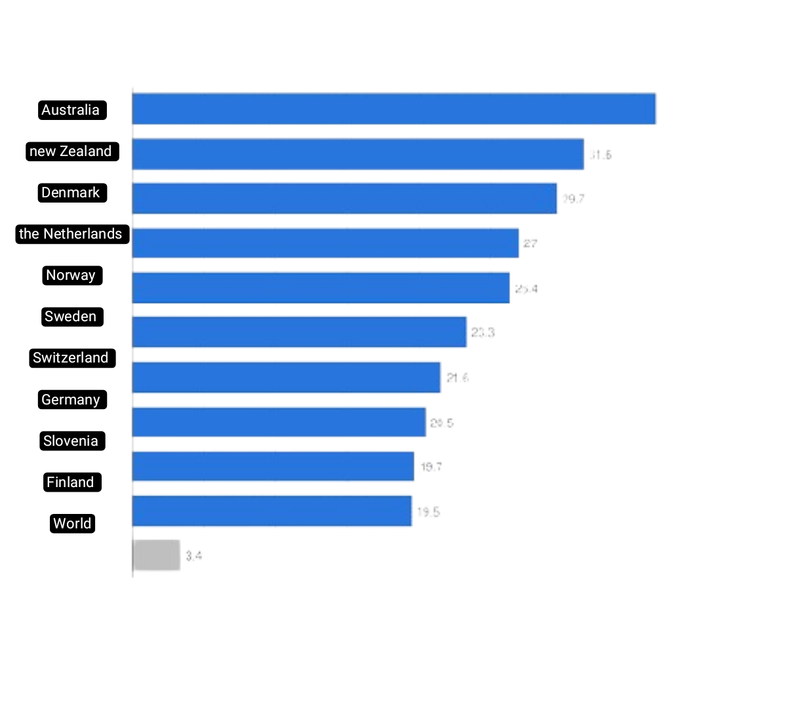
Skin cancers are the most common groups of cancers diagnosed worldwide, with more than 1.5 million new cases estimated in 2022.
In 2023 an estimated 330 000 new cases of melanoma were diagnosed worldwide and almost 60 000 people died from the disease.

Slide 6
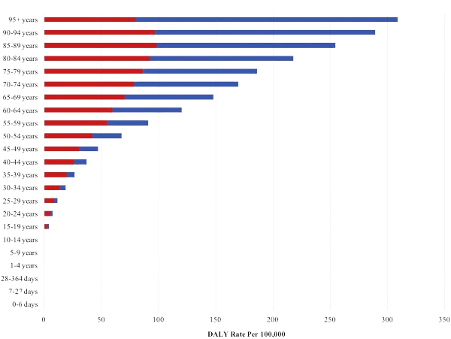
You can also note here that skin cancer spreads widely at all ages, from the age of 10 years to the very latest Therefore, we must diagnose it early and search for real ways to treat it ":

Slide 7
Our app delivers rapid, accurate analysis of skin lesions with its Flutter interface and CNN technology.
Our app uses a smartphone camera and artificial intelligence to analyze and classify skin lesions if lesions is benign or malignant.
It facilitates consultations with local doctors and provides educational resources for proactive skin health management.

Slide 8
Related Works

Slide 9
Skin Vision: Skin Vision uses AI to analyze photos of skin lesions for potential signs of skin cancer. this app limitation is false positives and false negatives are possible. The app provides risk assessments and recommendations for further evaluation but is not a substitute for professional medical advice.
Miiskin: Miiskin uses AI to track and monitor changes in moles and skin lesions over time. this app limitation is that it does not provide a diagnostic assessment.
Ada Skin Check: Ada Skin Check uses AI to analyze photos of skin lesions and provide risk assessments. this app limitation is that it results in false positives and false negatives can occur.
Skin IO: Skin IO employs AI to assess and analyze skin images for potential signs of skin cancer. this app limitation is accuracy of AI-based analysis is contingent on the quality of the data and algorithms.

Slide 10
Comparison between existing works
Function Name | Skin Vision | Miiskin | Ada Skin Check | Skin IO | Skin Cancer
Image Recognition | ✔ | ✔ | ✔ | ✔ | ✔
Risk Stratification | ✔ | ❌ | ❌ | ❌ | ✔
Educational Resources | ✔ | ✔ | ❌ | ❌ | ✔
User Feedback | ❌ | ❌ | ✔ | ✔ | ✔
Login | ✔ | ✔ | ✔ | ✔ | ✔
Signup | ✔ | ✔ | ✔ | ✔ | ✔
Forget password | ✔ | ✔ | ✔ | ✔ | ✔
Delete Account | ✔ | ✔ | ✔ | ✔ | ✔
Real-time chat | ❌ | ❌ | ❌ | ❌ | ✔
Logout | ✔ | ✔ | ✔ | ✔ | ✔

Slide 11
Machine-Learning

Slide 12
We gathered our dataset from Kaggle, focusing on images relevant to our skin cancer detection application. Specifically, we ensured that the dataset included images from four essential classes: benign, malignant, normal, and undefined.
Our meticulously curated dataset, sourced from Kaggle, was not only comprehensive but also ready for immediate use in our skin cancer detection application and start preprocessing it.
Source: https://www.kaggle.com/datasets/fanconic/skin-cancer-malignant-vs-benign

Slide 13
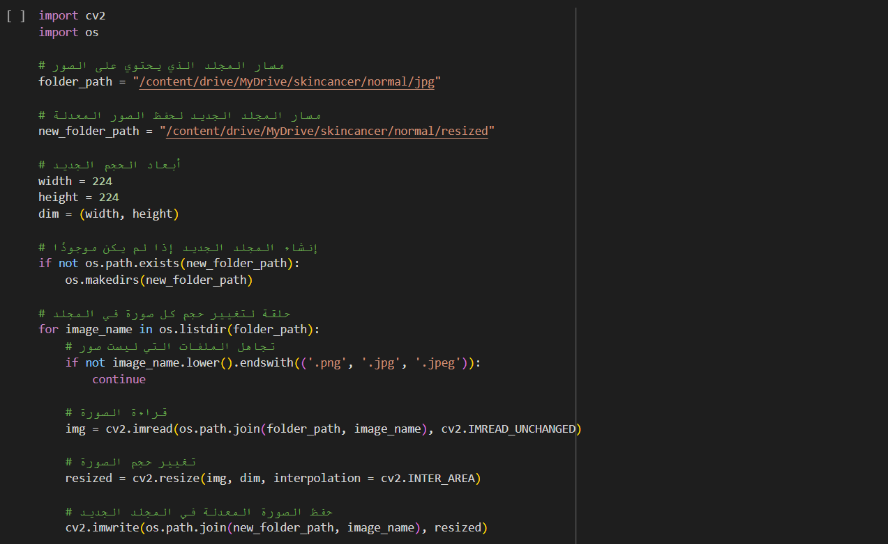
We start off with resizing as our first step in preprocessing images related to skin cancer detection.
It reads images from a folder, resizes them, and saves the resized versions to a new folder.
This ensures that the images are ready for further analysis or use in the application.

Slide 14
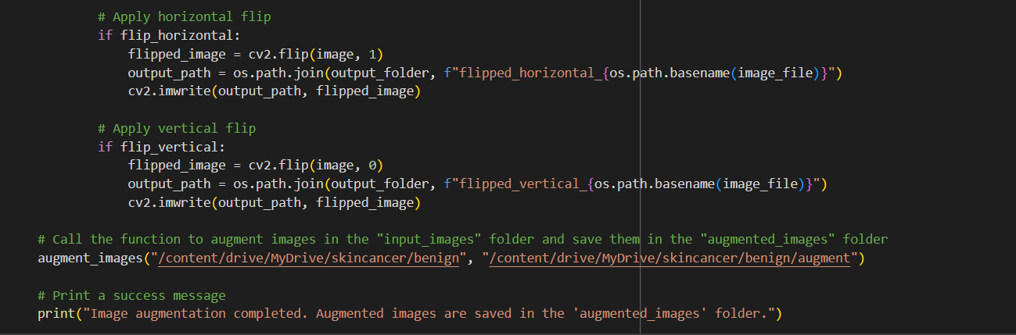
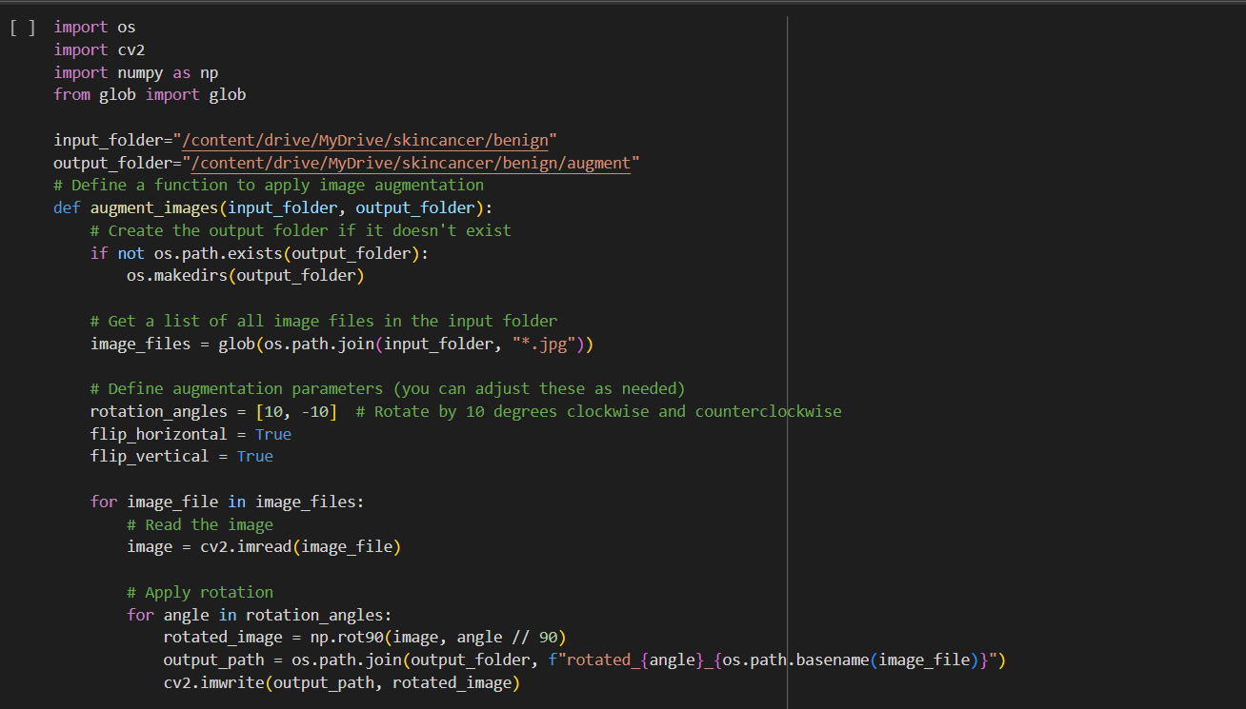
Next step serves the purpose of augmenting the dataset.
By applying rotations and optional flips to the original images, it generates variations that can enhance model training and improve overall performance.
The augmented images are then saved for further analysis or use in the skin cancer detection application.

Slide 15
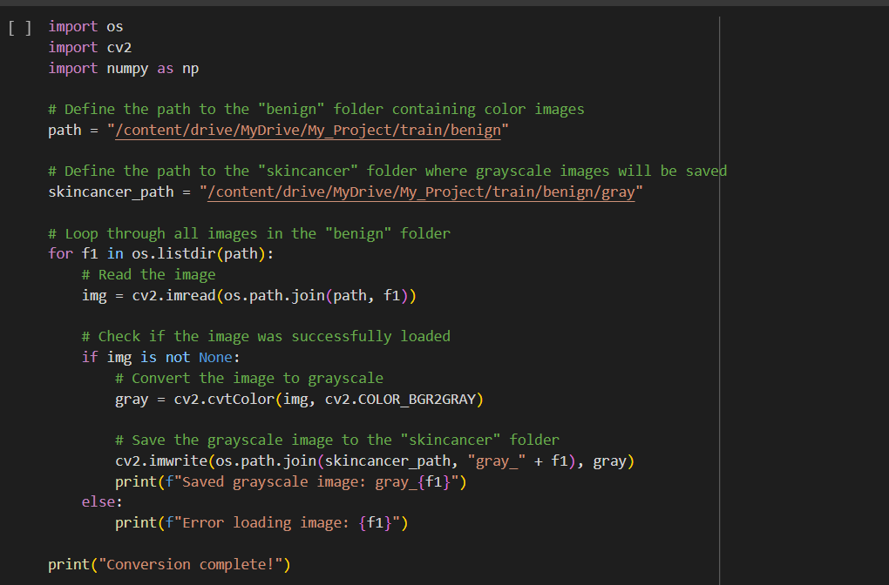
Next step is graying where we process color images related to skin cancer and convert them to grayscale.
The resulting grayscale images are then saved in a separate folder named “.gray”.
This conversion is often done to simplify image processing tasks or reduce computational complexity while preserving relevant information.

Slide 16
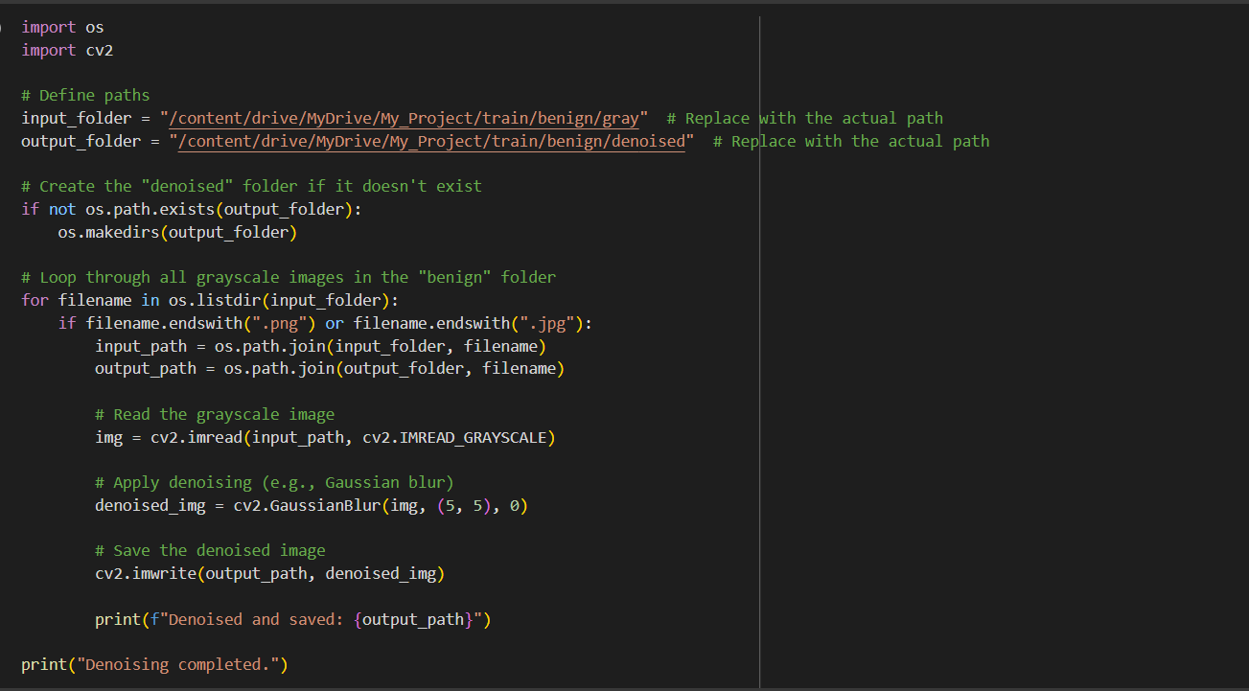
Next step is noise removal of the picture.
Denoising is a common preprocessing step in image processing that helps to reduce noise and improve the clarity of the image content.
The purpose of this script is to automate the process of denoising a collection of images, which can be particularly useful for preparing data for machine learning tasks or improving the visual quality of images.

Slide 17
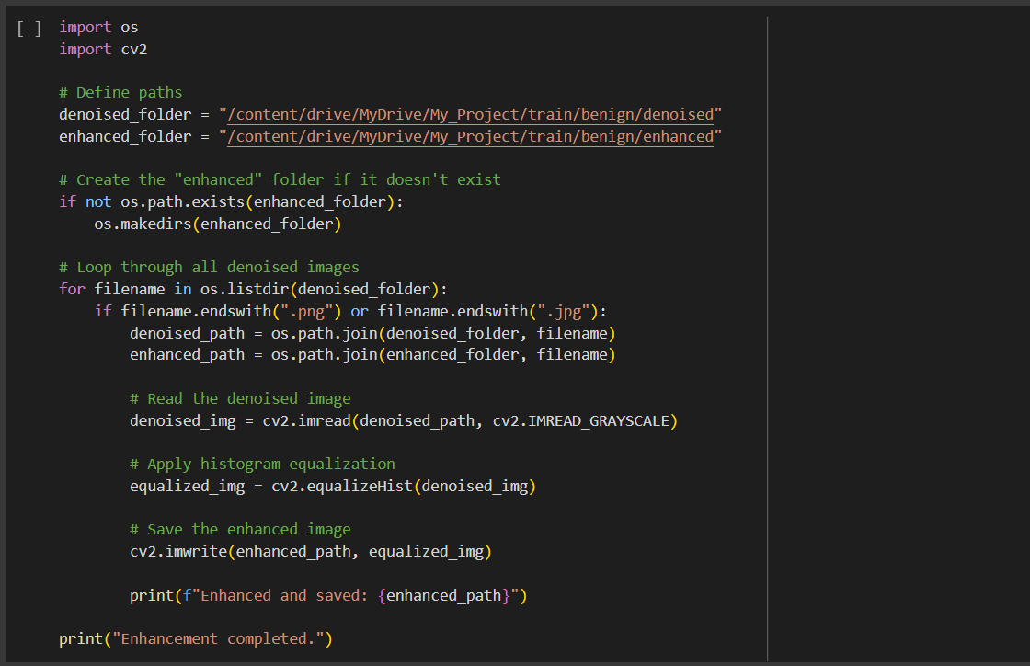
Next step is image enhancement of all the images.
The purpose of the code is to enhance images from a denoised folder.
It achieves this by applying histogram equalization to improve contrast, resulting in visually enhanced images.

Slide 18
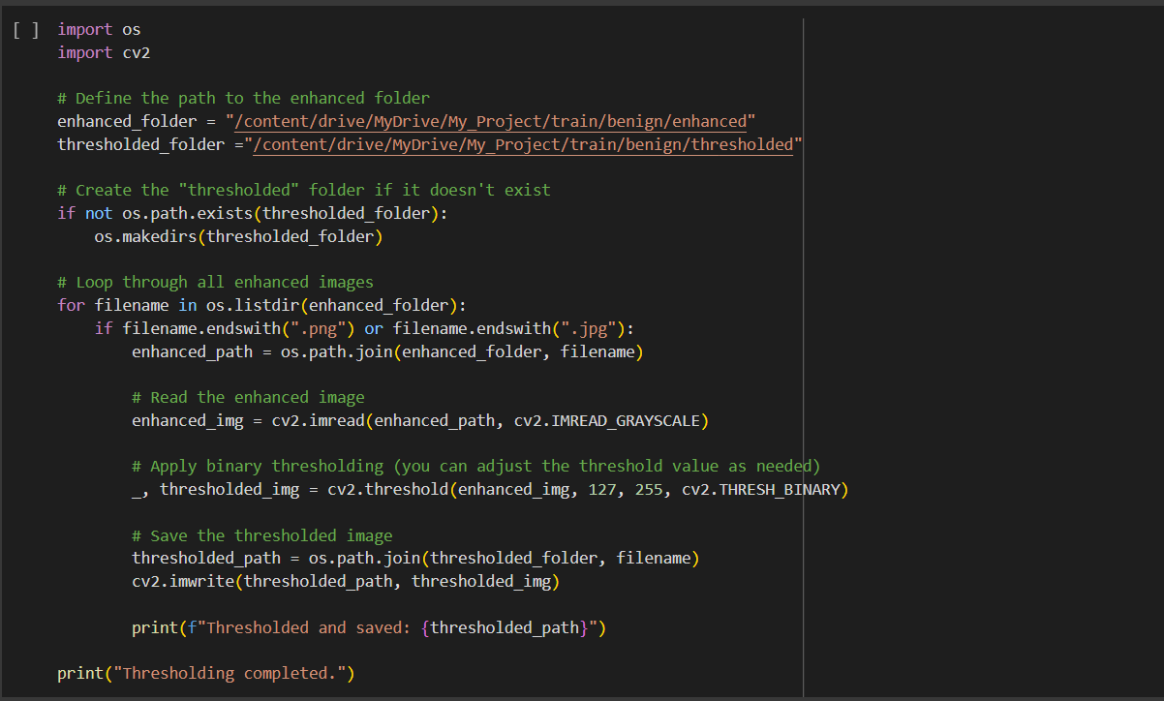
Next is thresholding the images of our dataset.
The purpose of the code is to perform image thresholding on the enhanced images from the specified folder.
It achieves this by applying binary thresholding to create a black-and-white representation of the images.

Slide 19
Training Model
Our final step was to train our model on the preprocessed images of the dataset.
We trained a custom image classification model using transfer learning with MobileNetV3Small as the base, freezing its weights. A new top layer was added, featuring global average pooling, a dense layer with 512 ReLU units, dropout, and a 4-unit softmax output for classification.
The model was compiled with the Adam optimizer and categorical cross-entropy loss, then trained for 100 epochs with images resized to 224x224 pixels from the specified directory.
The final model achieved 96% accuracy and was saved as 'my_model.h5'.

Slide 20
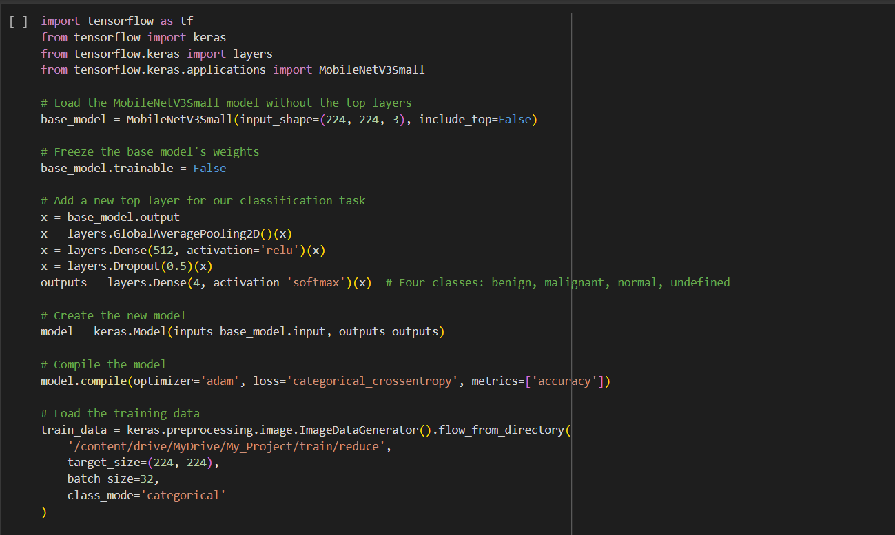
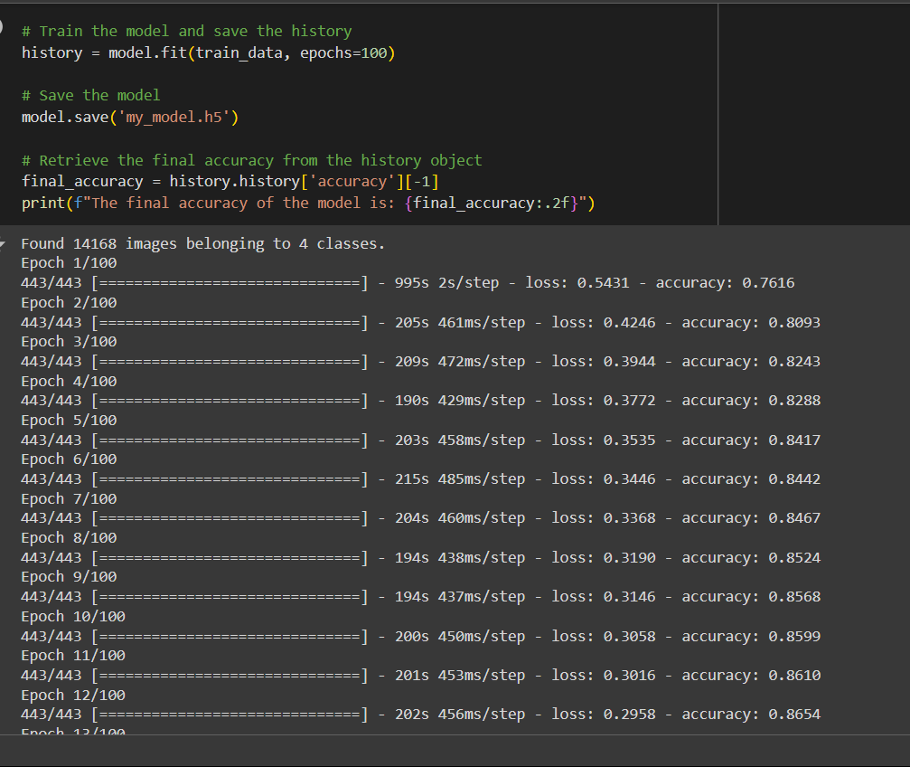
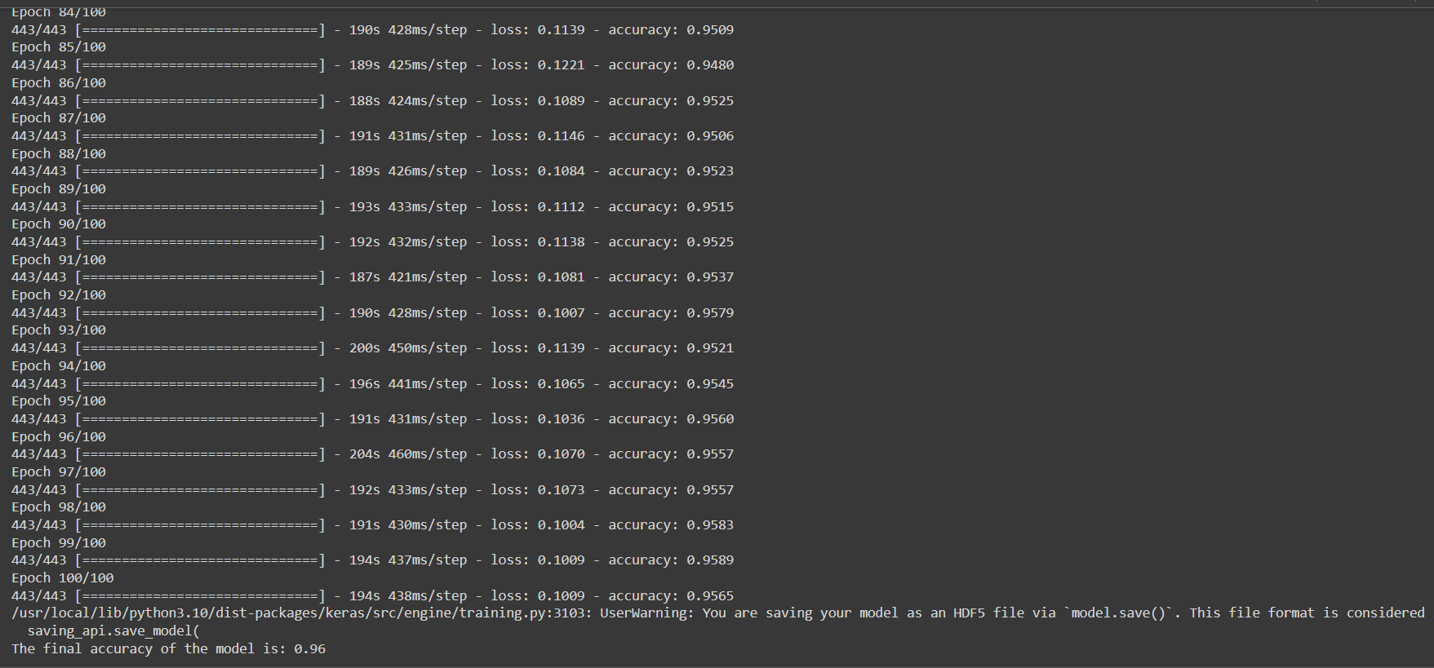
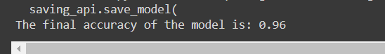

Slide 21
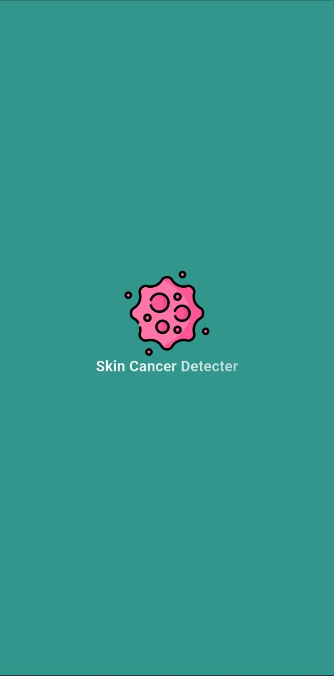
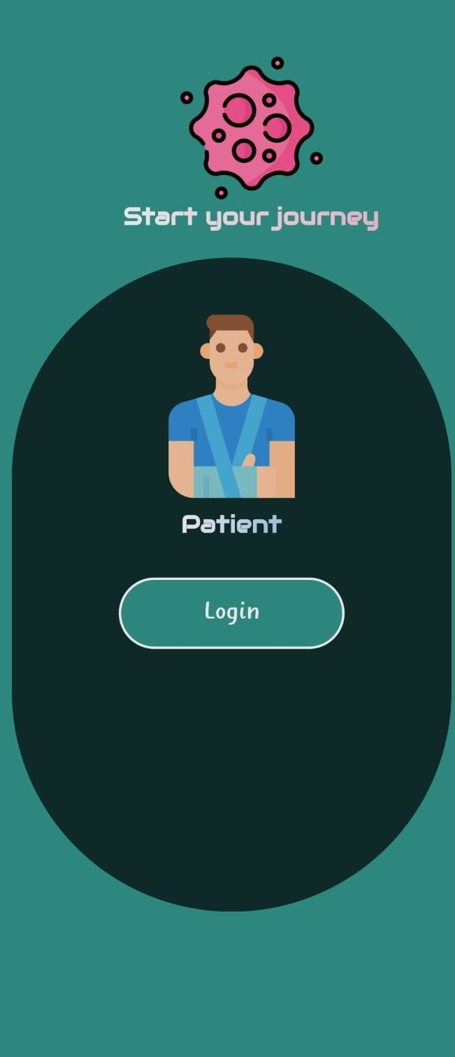
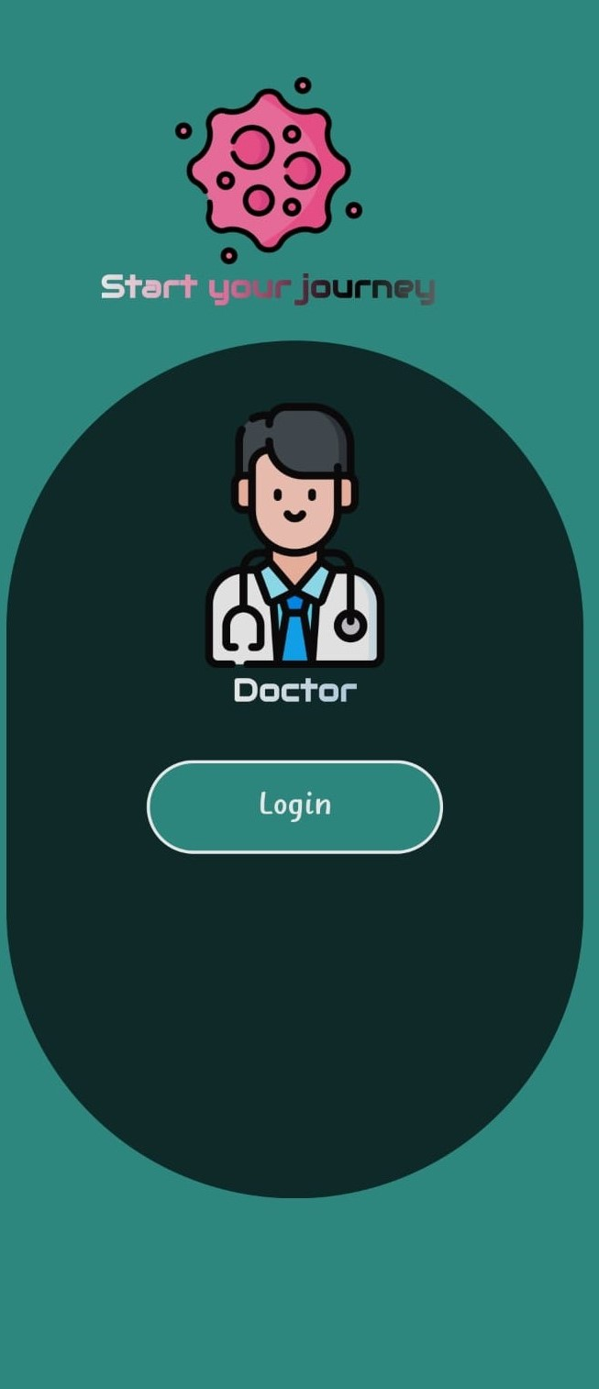
System Design

Slide 22
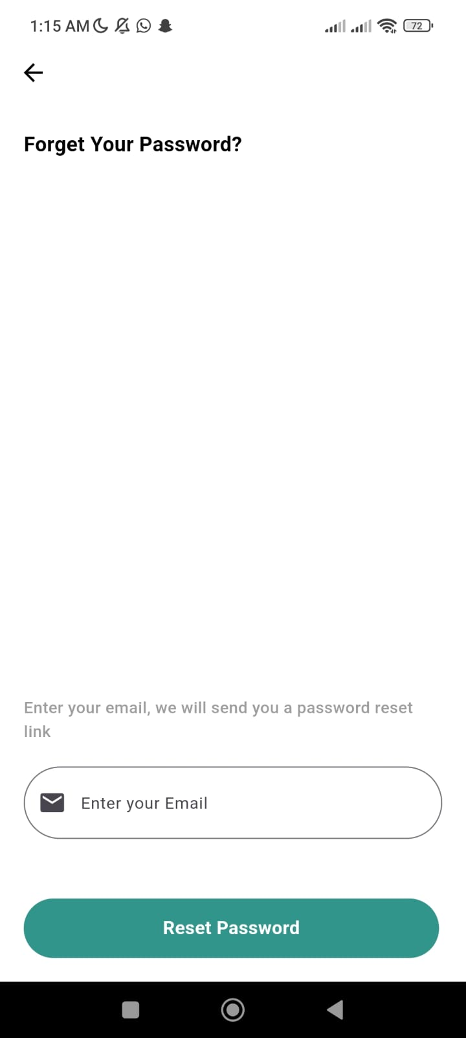
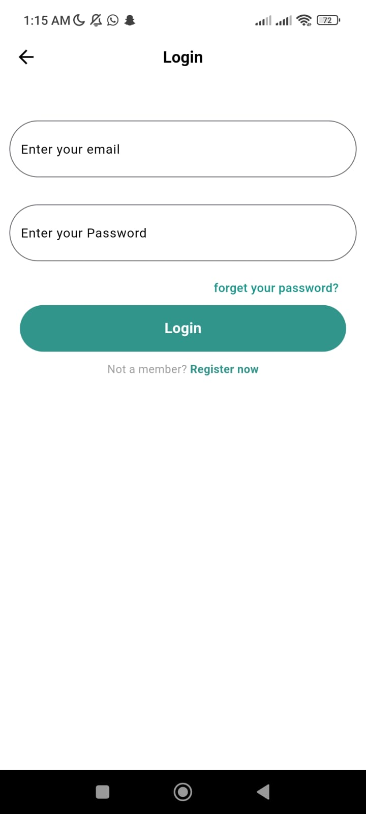
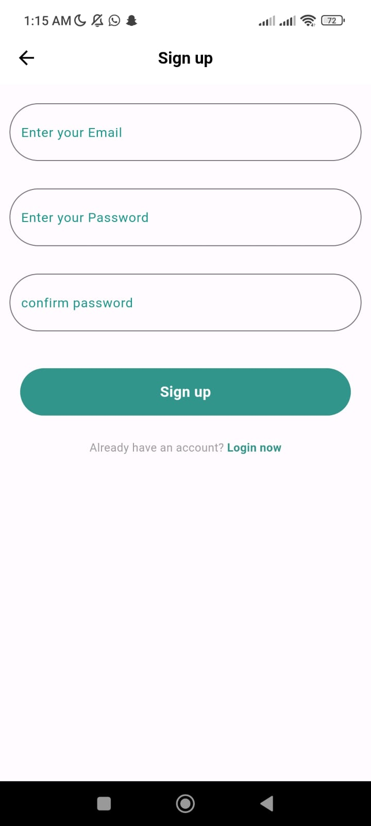
As you can see in the figures, the first page that patients and doctors meet is to register for the application.
If they already have an account, they can log in right away.
In case they forget their password, they can reset it by providing their attached email.

Slide 23
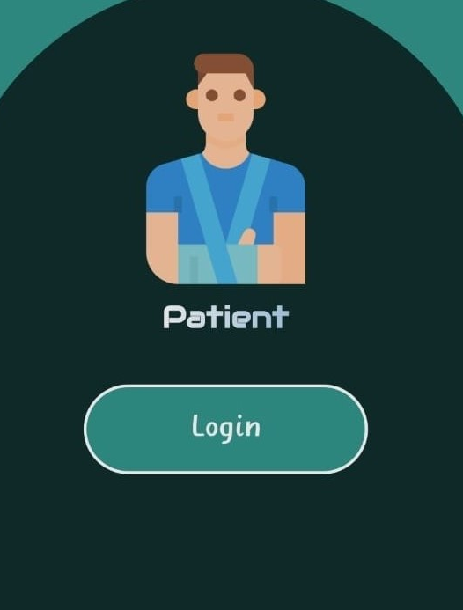
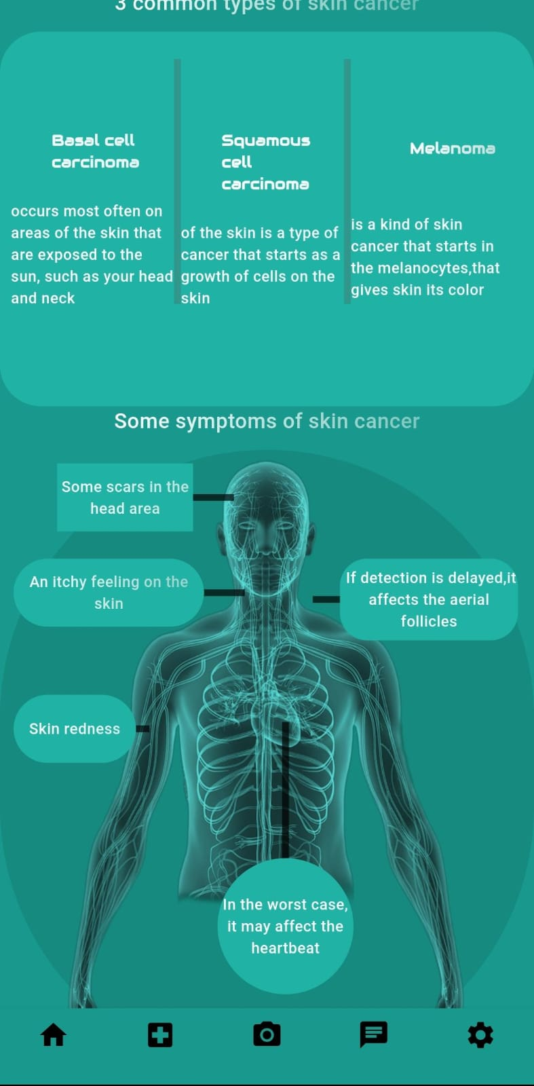
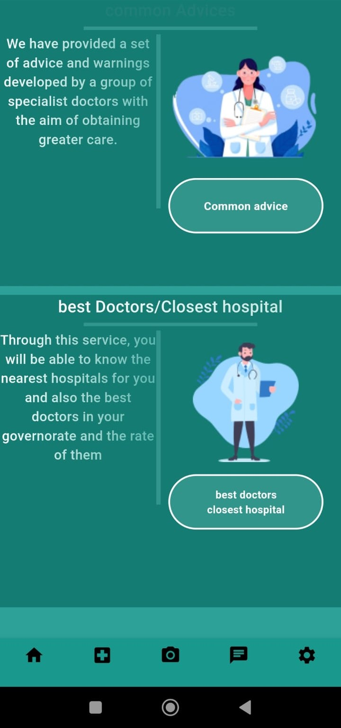
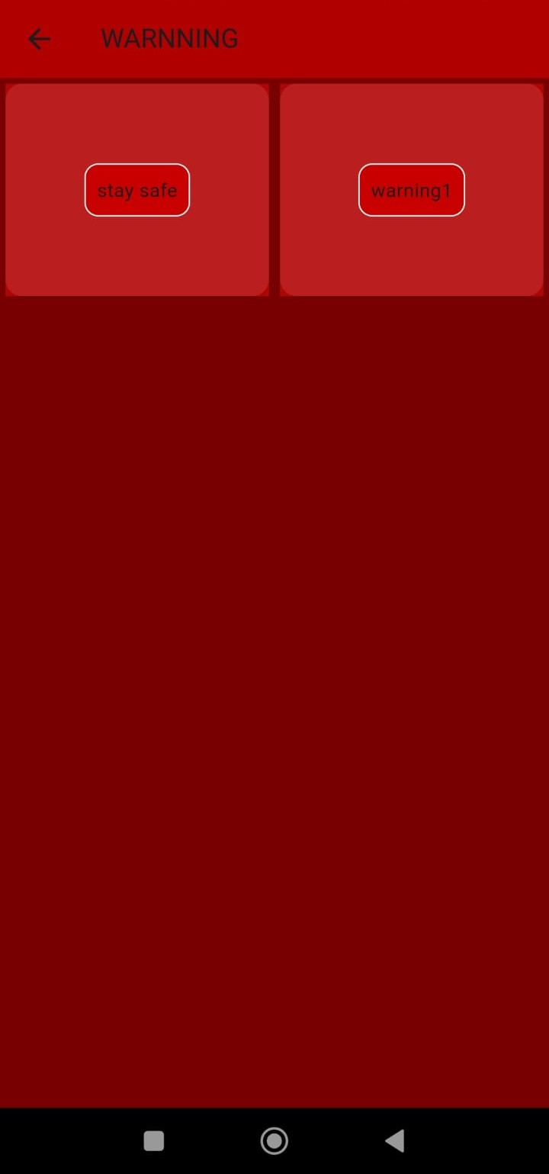
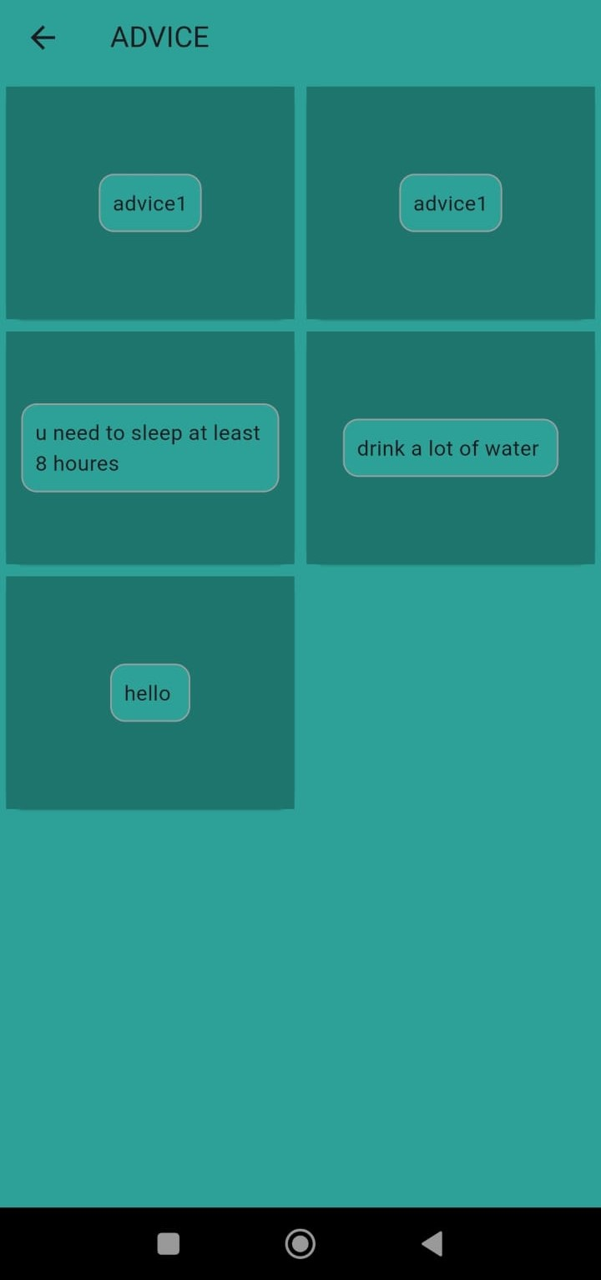
The patient-side home page of our skin cancer detection app provides a wealth of valuable resources.
Users can access educational materials, find nearby hospitals and top-rated doctors, and receive general advice and warnings from dermatologists.
It’s a comprehensive hub for skin health awareness and proactive care.

Slide 24
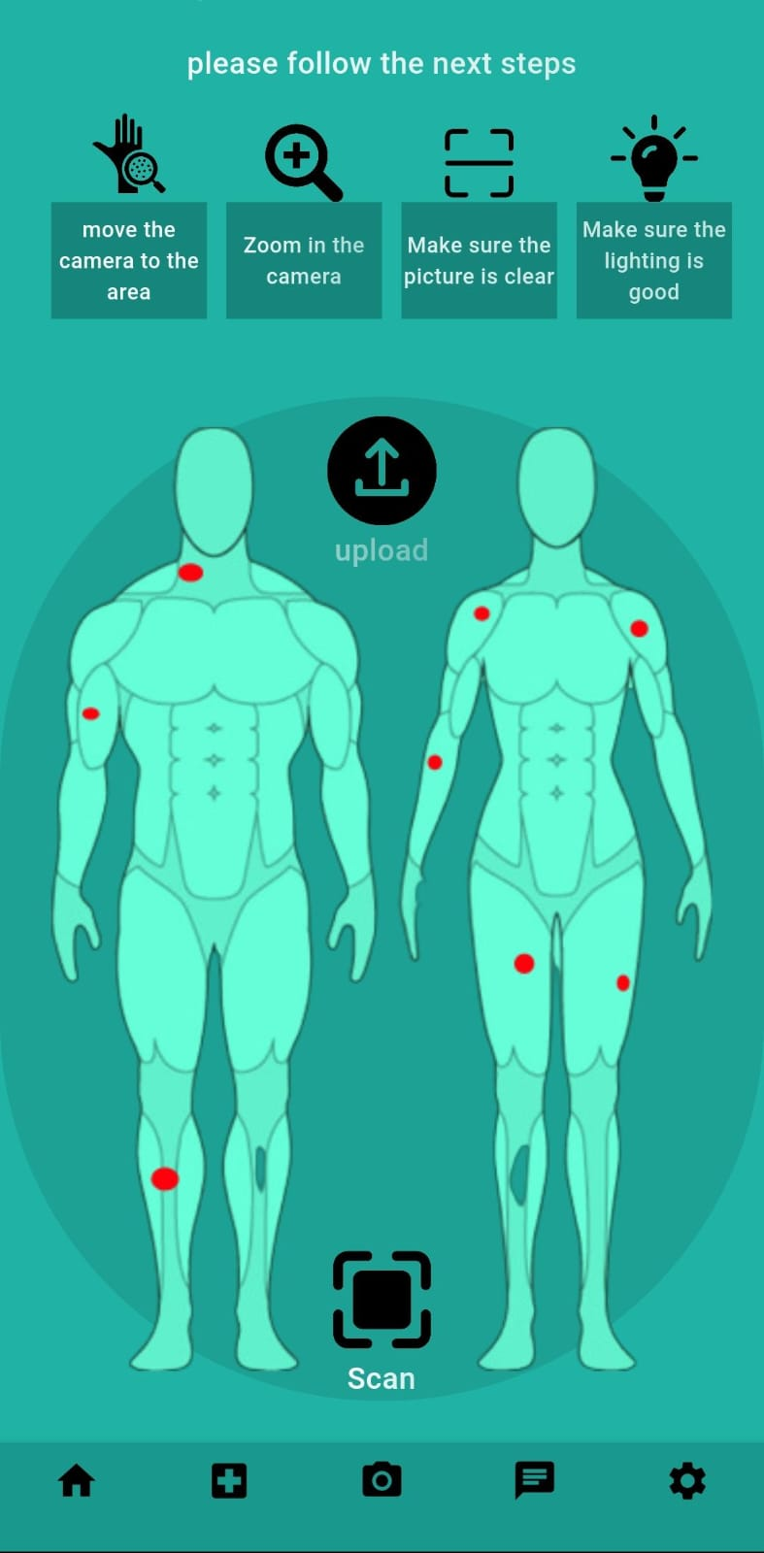
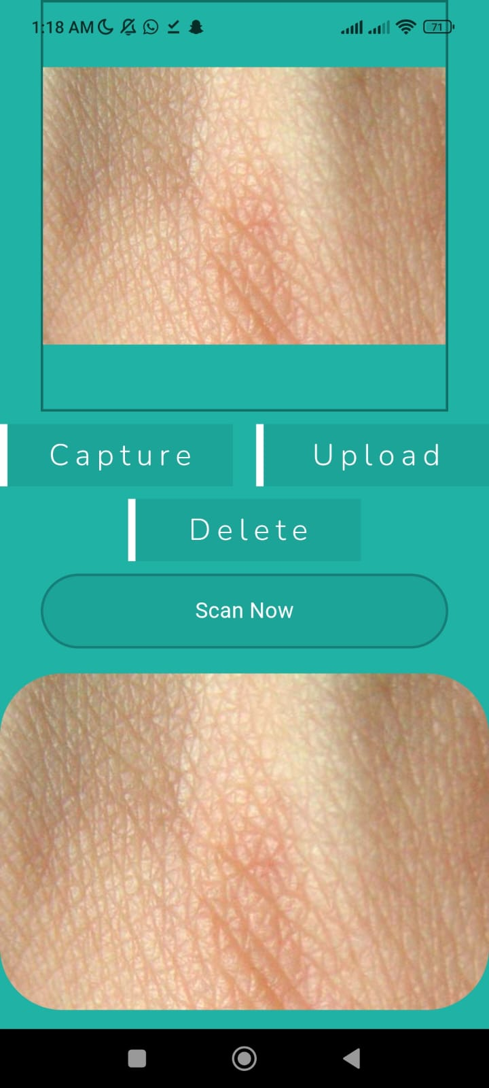
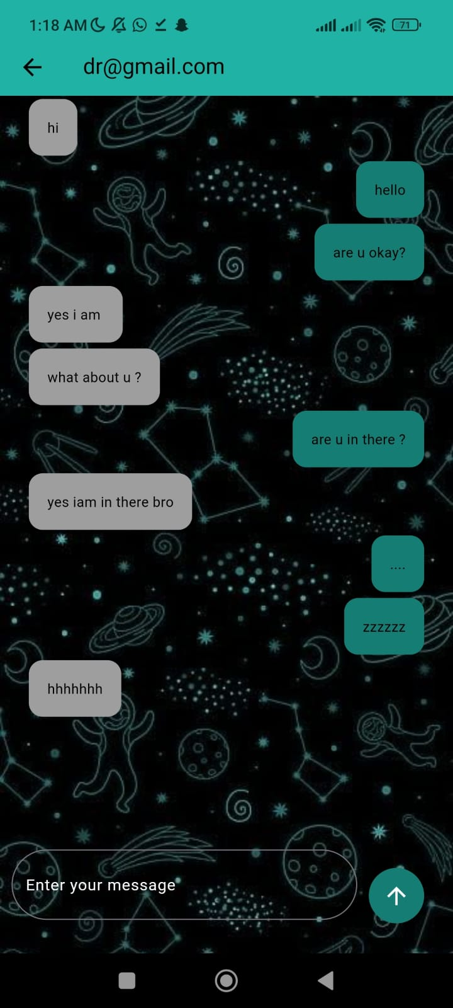
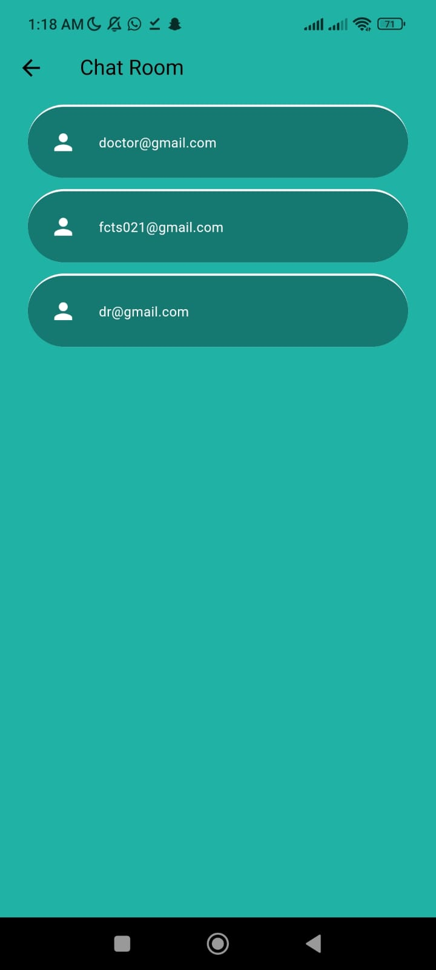
On the scanning page, patients have two options: upload or capture.
If they choose to upload, they can select an existing skin image from their device. Alternatively, they can use the capture feature to take a new photo. Once the image is processed, the app performs a thorough analysis.
It categorizes the skin image as benign, malignant, or normal. If the image quality is insufficient or unclear, the app prompts the user to reupload for better results.
After receiving the diagnosis, patients can engage in a chat with a doctor. This allows them to discuss the results, their case, and any necessary follow-up or tracking.

Slide 25
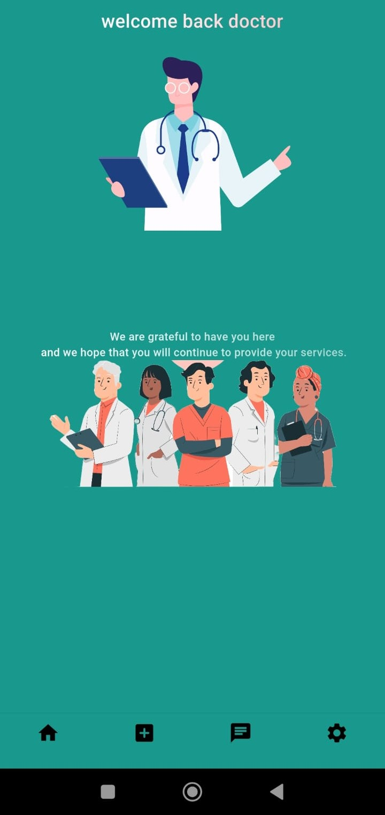
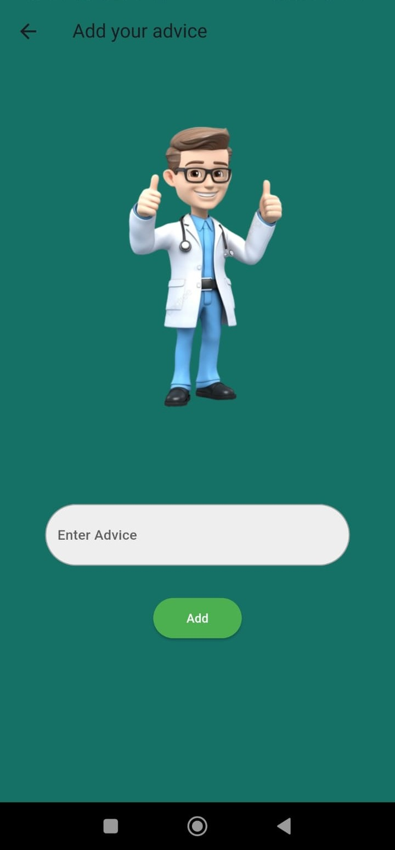
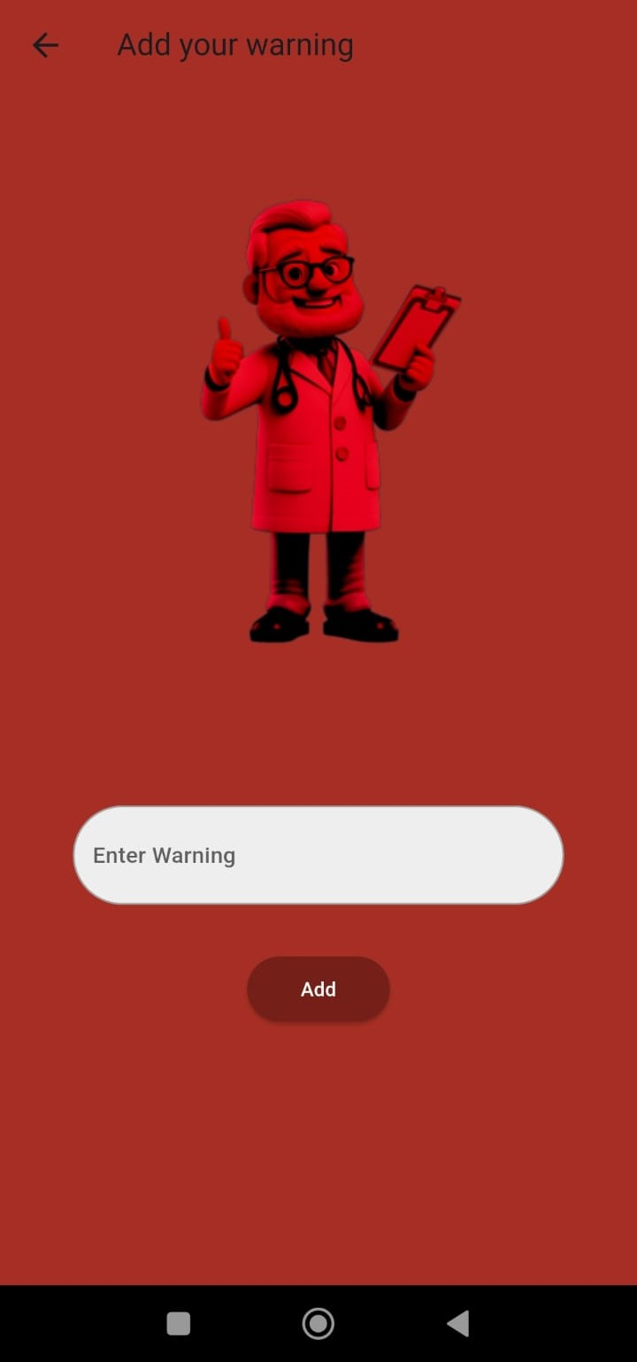
On the doctor side of our skin cancer detection app, healthcare professionals have several essential features.
They can add and edit general advice and warnings that patients receive.
Additionally, doctors can respond to patients in the chat section. They provide insights about the patient’s case, offer additional information, and discuss necessary follow-up steps.
This seamless communication ensures personalized care and empowers doctors to guide patients effectively.

Slide 26
Backend

Slide 27
Firebase
Firebase is a development platform offered by Google that provides a suite of tools and services for building applications, enhancing performance, and increasing user engagement.
Firebase includes many products that help developers handle various aspects of app development, from storage to analytics and notifications.

Slide 28
Firestore
Firestore is a NoSQL cloud database from Firebase, designed for storing and syncing data across apps. It offers powerful features such as:
Flexible Data Storage
Real-Time Synchronization
Strong Security

Slide 29
Firebase Authentication
Firebase Authentication is an identity management system that provides various methods for user sign-in and authentication. It helps improve the security and ease of use of our app through:
Multiple Sign-In Methods
User Management
Easy Integration

Slide 30
Our Application Usage
In our application, you used Firestore to store and manage data flexibly and efficiently, allowing for a smooth user experience with real-time updates. Additionally, we utilized Firebase Authentication to provide secure and easy login options for users, enhancing both the security and accessibility of the app.

Slide 31
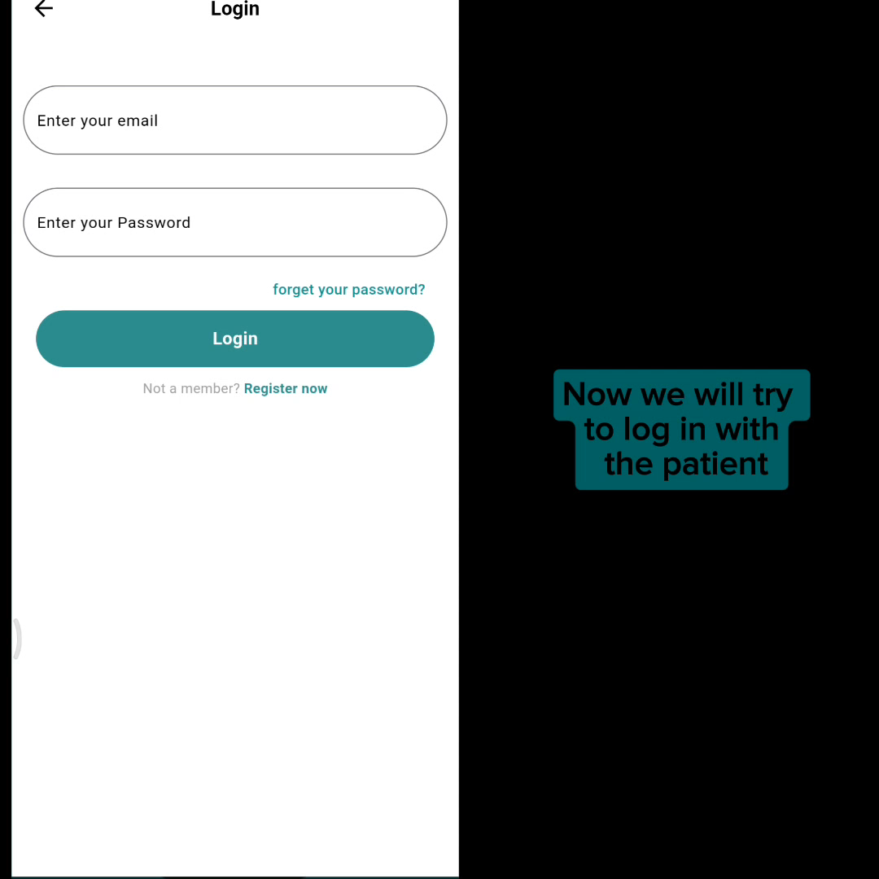
System Demo
Patient

Slide 32
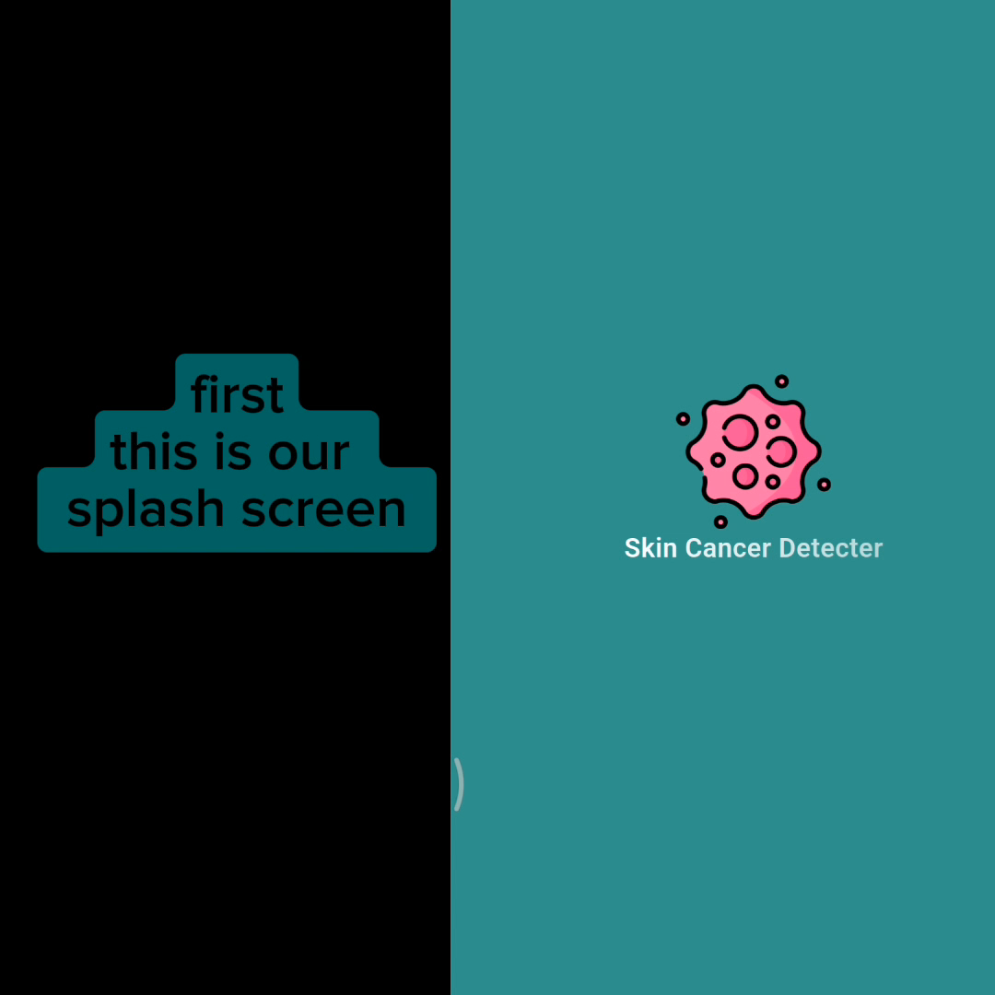
System Demo
Doctor

Slide 33

Conclusion
Our skin cancer detection app is user-friendly, innovative, and committed to early intervention. It empowers global users in the fight against skin cancer by combining precise algorithms with continuous improvement efforts. Let’s embrace a future where proactive detection leads to healthier outcomes!
Thank you

